Slide 1
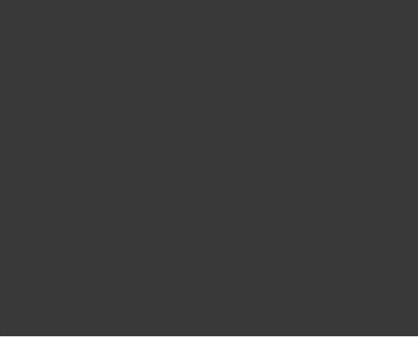

ENF-26 Suspicious Transactions
Compliance Training
The Nevada Gaming Control Board’s Enforcement Division announces the launch of online Suspicious Transaction Reporting beginning December 01, 2020.
  Each licensee responsible for the submission of Suspicious Transaction Reports must designate one or more users to submit these reports online and ensure such persons have access accounts for the system. This must be done by the Location Administrator for each property. If you have any questions regarding this process, please contact Jared Hoopes in the Enforcement Division at (702) 486-2213 or jhoopes@gcb.nv.gov.
This presentation is for educational purposes only. Opinions or points of view expressed in this presentation represent the view of the presenter, and does not necessarily represent the official position or policies of the Nevada Gaming Control Board or the Nevada Gaming Commission. Nothing in this presentation constitutes legal advice. The individuals appearing in this presentation, if any, are depicted for illustrative purposes only and are presumed innocent until proven guilty in a court of law.

Slide 2
Table of Contents
Section | Page #
Getting Started | 3
Logging into GCBApps | 4
Create an ENF-26 Form | 7-9
Header Information | 10-11
Add, Edit & Delete Suspects | 12-16
Transaction Activities | 17
Transaction Details | 18
Save & Submit | 19-20
Forms in process | 21-23
Amend Forms | 24-26
Filing History | 27

Slide 3
Getting Started
Access to Suspicious Transaction forms is available through the NV Gaming Control Board site at https://gcbapps.nv.gov/
User Accounts must be assigned by the Location Administrator to gain access to Regulatory Forms for the ENF-26. To obtain a user account to access ENF-26/Suspicious Transactions:
  The Location Administrator, for the licensed location, creates and/or assigns the user account. Every location has a Location Administrator.
  The Location Administrator will search for the user that has been designated to create and submit their BWR forms and either
  1) Add the Regulatory Forms application to their existing account or
    2) Create a new user account and add the Regulatory Forms application to the new user account.
Compliance requirements for Suspicious Transactions are found at:
  https://gaming.nv.gov/modules/showdocument.aspx?documentid=15427
  https://gaming.nv.gov/modules/showdocument.aspx?documentid=17094
Following this process helps to keep gaming industry locations in compliance per the NV Gaming Control Board industry statutes and regulations.

Slide 4
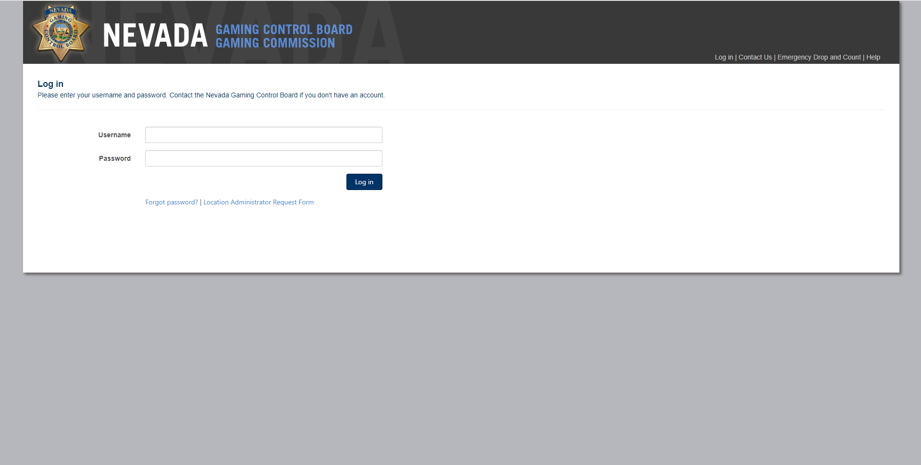
Log in: Use your GCB account username and password & click the Log in button.

Slide 5
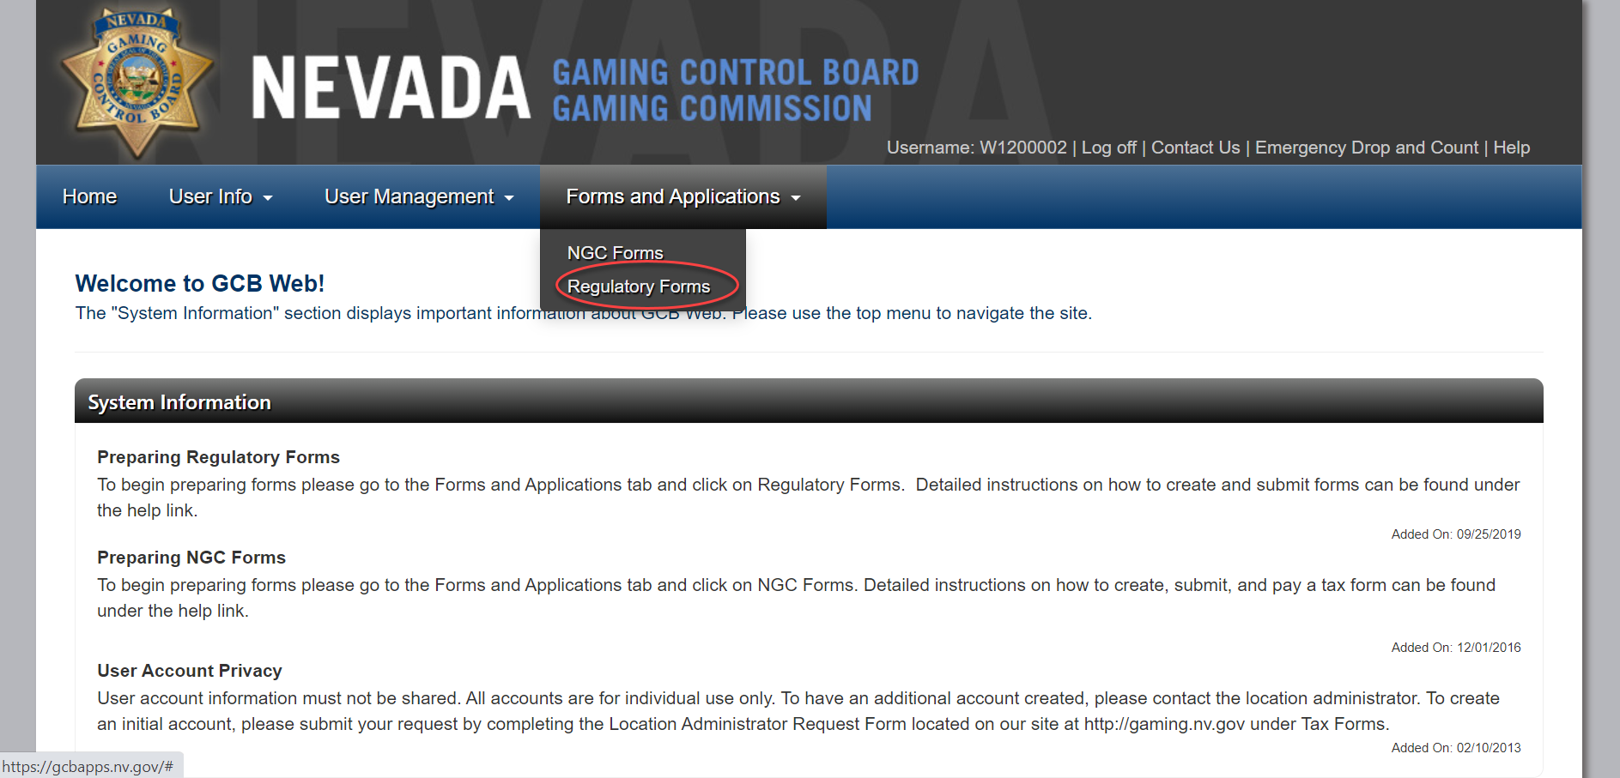
Welcome to GCB Web: Select Forms and Applications and then select Regulatory Forms

Slide 6
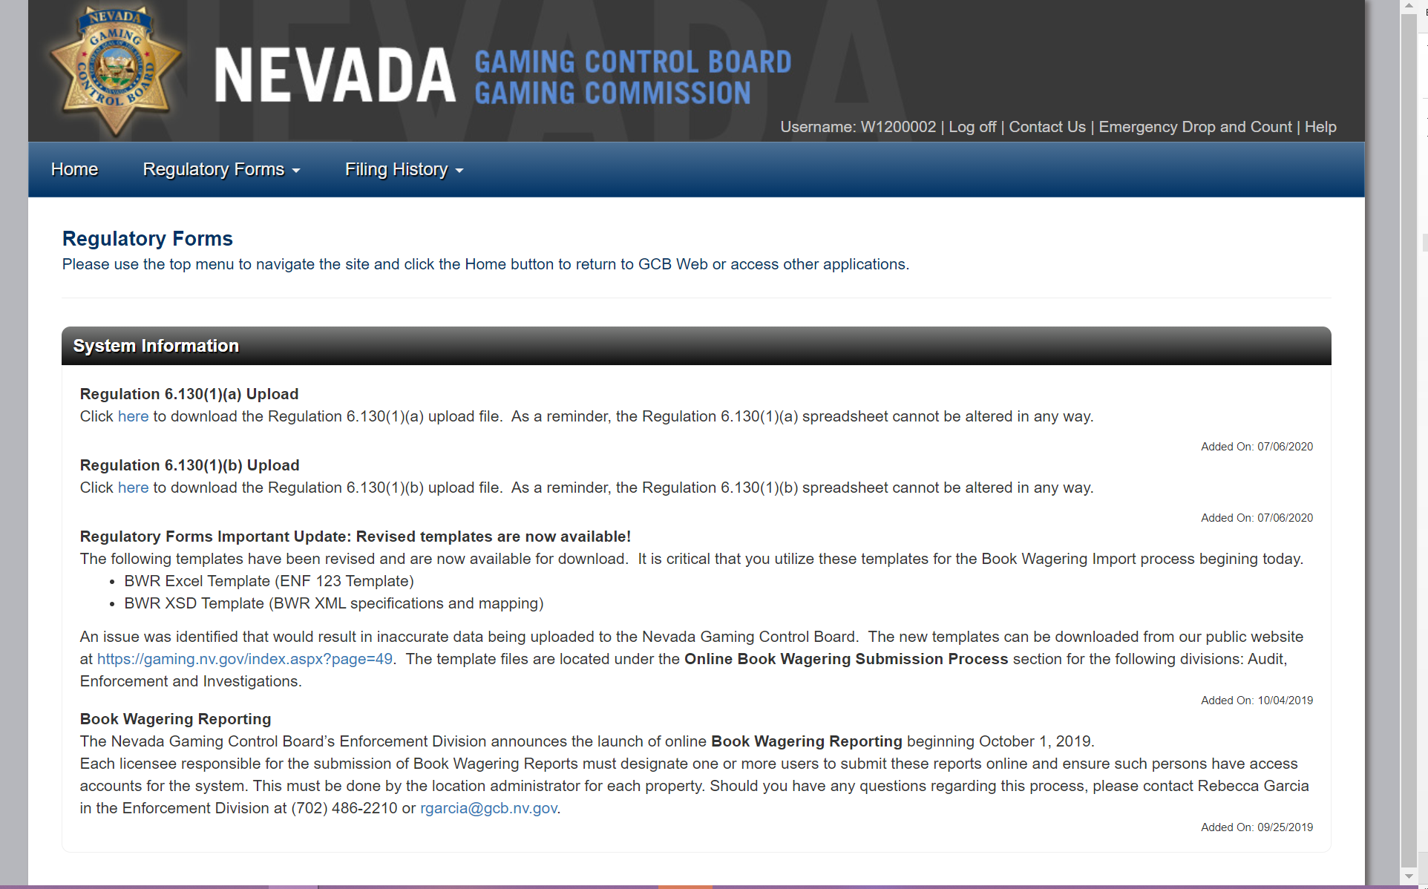
Regulatory Forms Landing page: System messages and announcements may be displayed here.

Slide 7
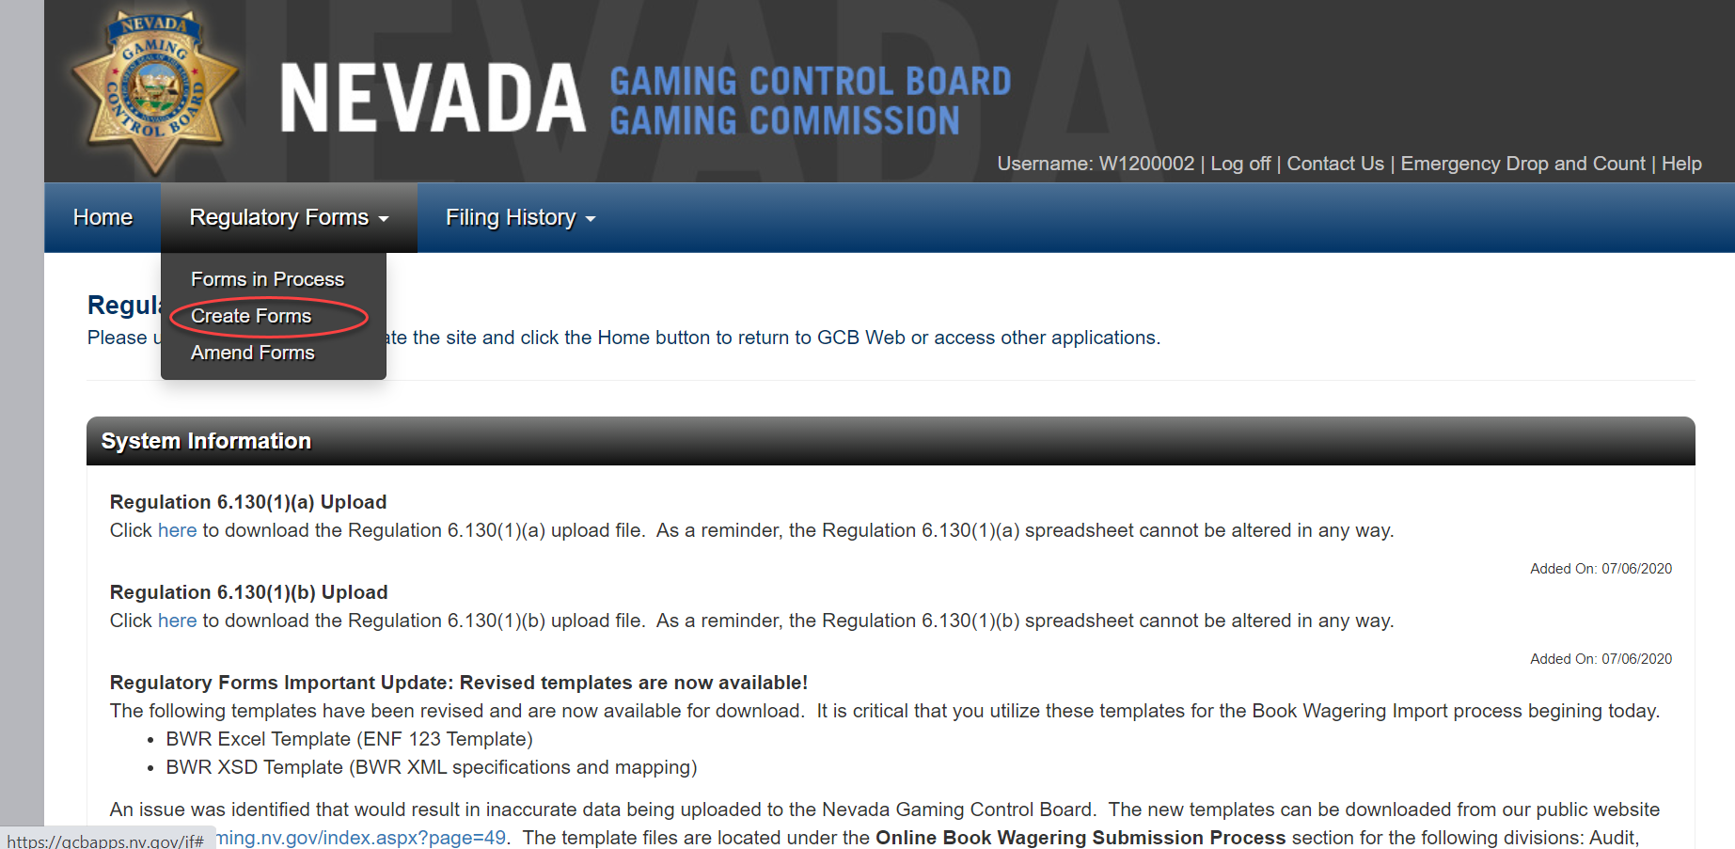
Create Forms: Select Create Forms from Regulatory Forms.

Slide 8
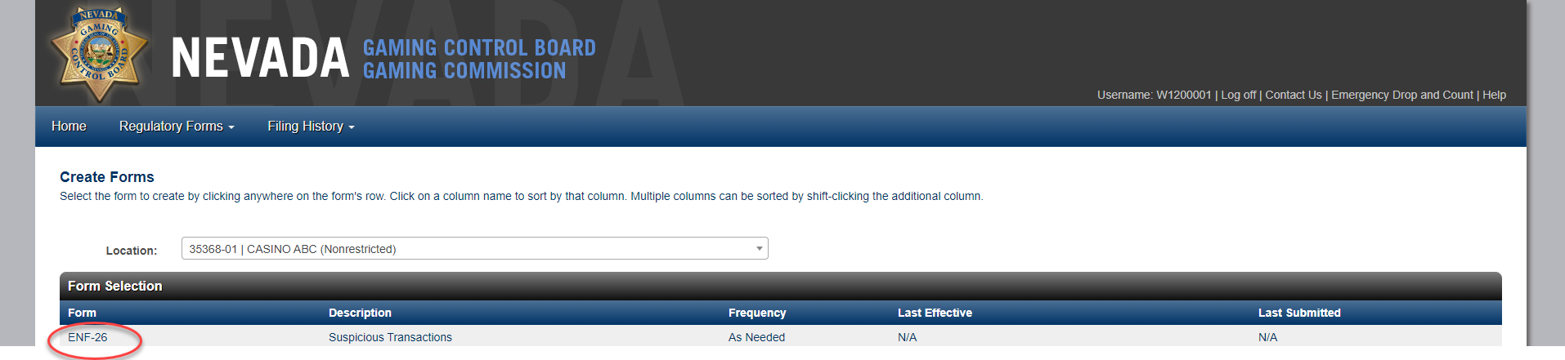
Create Forms: Available forms will be displayed.
Click the ENF-26 row to open the STR form.

Slide 9
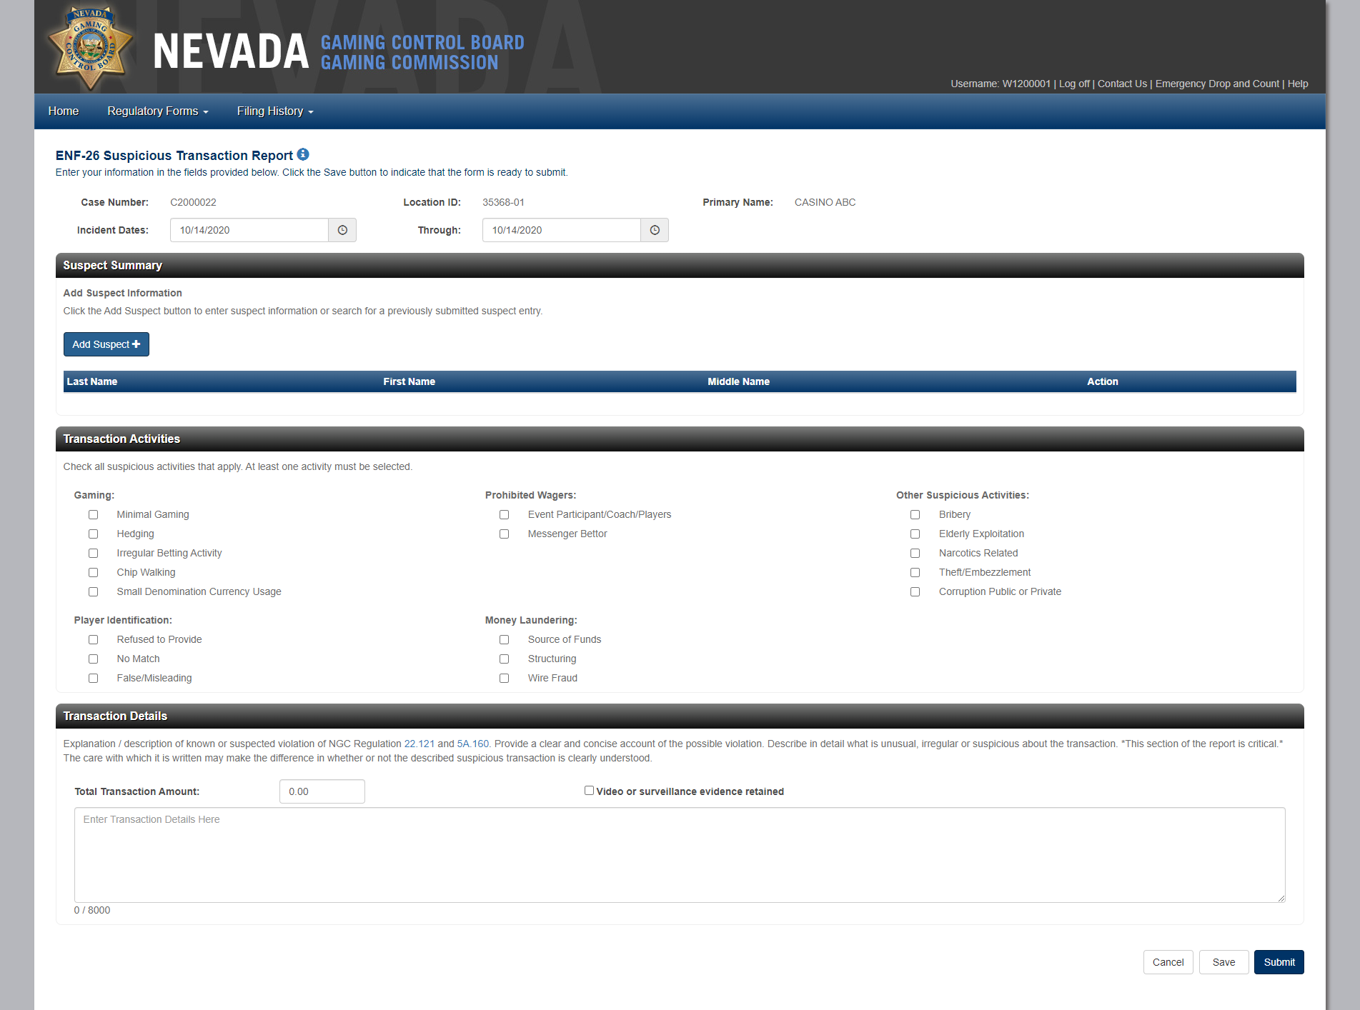

Create Forms: The ENF-26 form is displayed and contains Header Information, Suspect Summary, Add Suspect, Transaction Activities & Transaction Details. The form can be Canceled, Printed, Saved or submitted.

Slide 10
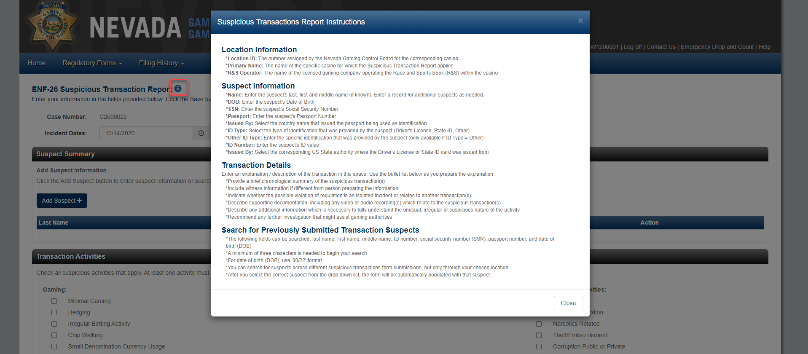
Header Information Icon: Click the icon next to the Title to reference instructions for filling out the ENF-26.

Slide 11
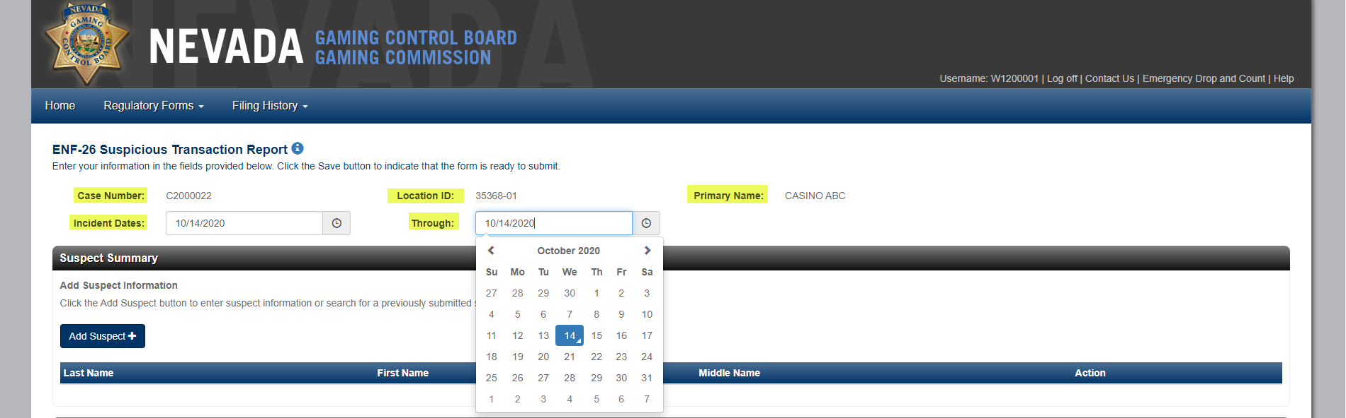
Header Information: Includes Case Number, Location ID, Primary Name, Incident Dates and Through.
Case Number: Prefilled & not editable, unique & systematically generated, assigned when an ENF-26 form is created & stays with the form through out it’s lifecycle (Forms in Process & Amendments).
Location ID & Primary Name: Prefilled & not editable, based on login credentials.
Incident Dates and Through fields: Required & default to current day, Through must occur after the Incident Date, click a date field to change date/date range.

Slide 12
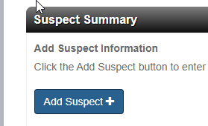
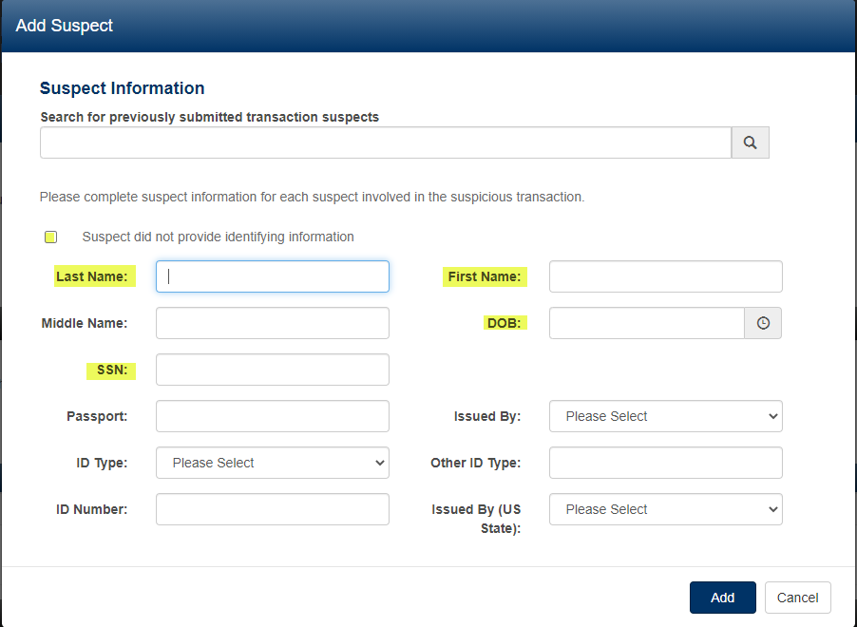
Suspect Summary: Click the Add Suspect button to open the Add Suspect modal
Known suspects: Enter information into the applicable fields(First Name/Last Name & either a DOB or SSN are required).
Unknown suspect: Check ‘Suspect did not provide identifying information’ box. Unknown will be prefilled in the Last Name field & all input fields will be disabled.
Upon Add, the suspect will be added to the Suspect Summary section
Repeat steps 1-2 if there are multiple suspects.

Slide 13
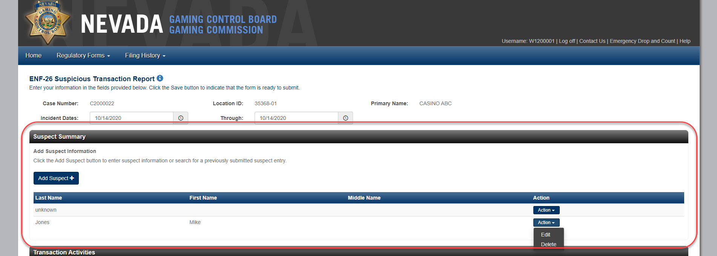
Suspect Summary: Suspects names will be included in the Suspect Summary Section each time a new suspect is added. These Suspects can be edited or deleted.

Slide 14
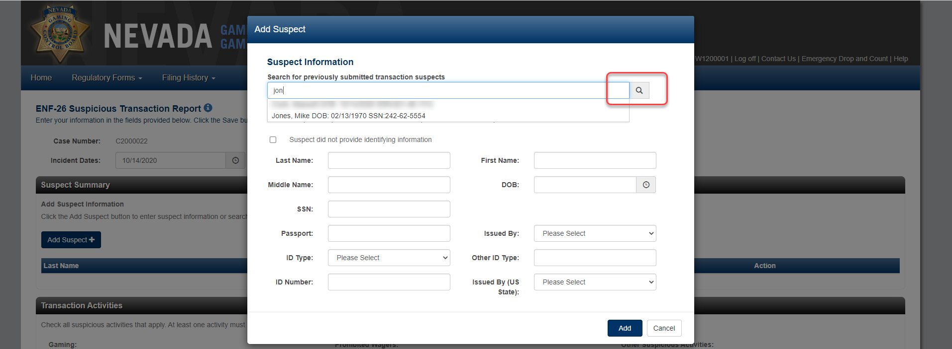
Add Suspect: Search for previously submitted suspects, select a suspect from the list to prefill the suspect data.

Slide 15
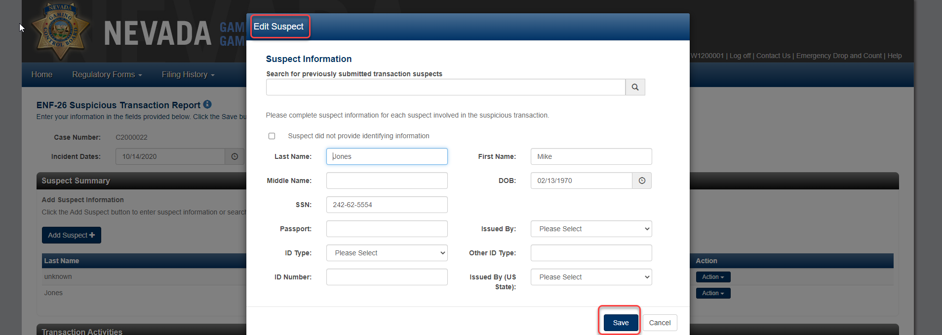
Suspect Summary: Click Edit to change suspect information. Fields are prefilled with the original data, make changes, then click Save to update the form. If name changes are made then these changes will display under Suspect Summary.

Slide 16
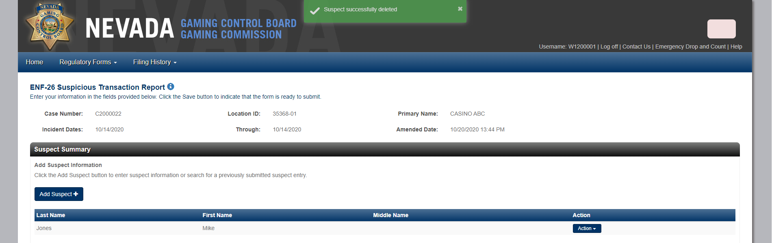
Suspect Summary Delete Action: Click Delete to remove a suspect from the Suspect Summary section. Once clicked this action cannot be undone.

Slide 17
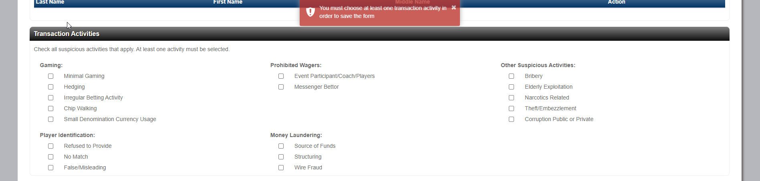
Transaction Activities: Click the applicable activities related to the transaction. At least one activity is required before clicking Save or Submit.

Slide 18
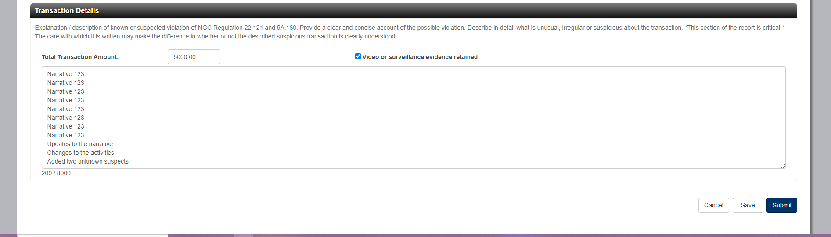
Transaction Details: Allows up to 8000 characters in length to explain/describe the known or suspected violation, text counts down and turns red to alert when the narrative is approaching the maximum limit of 8000.

Slide 19
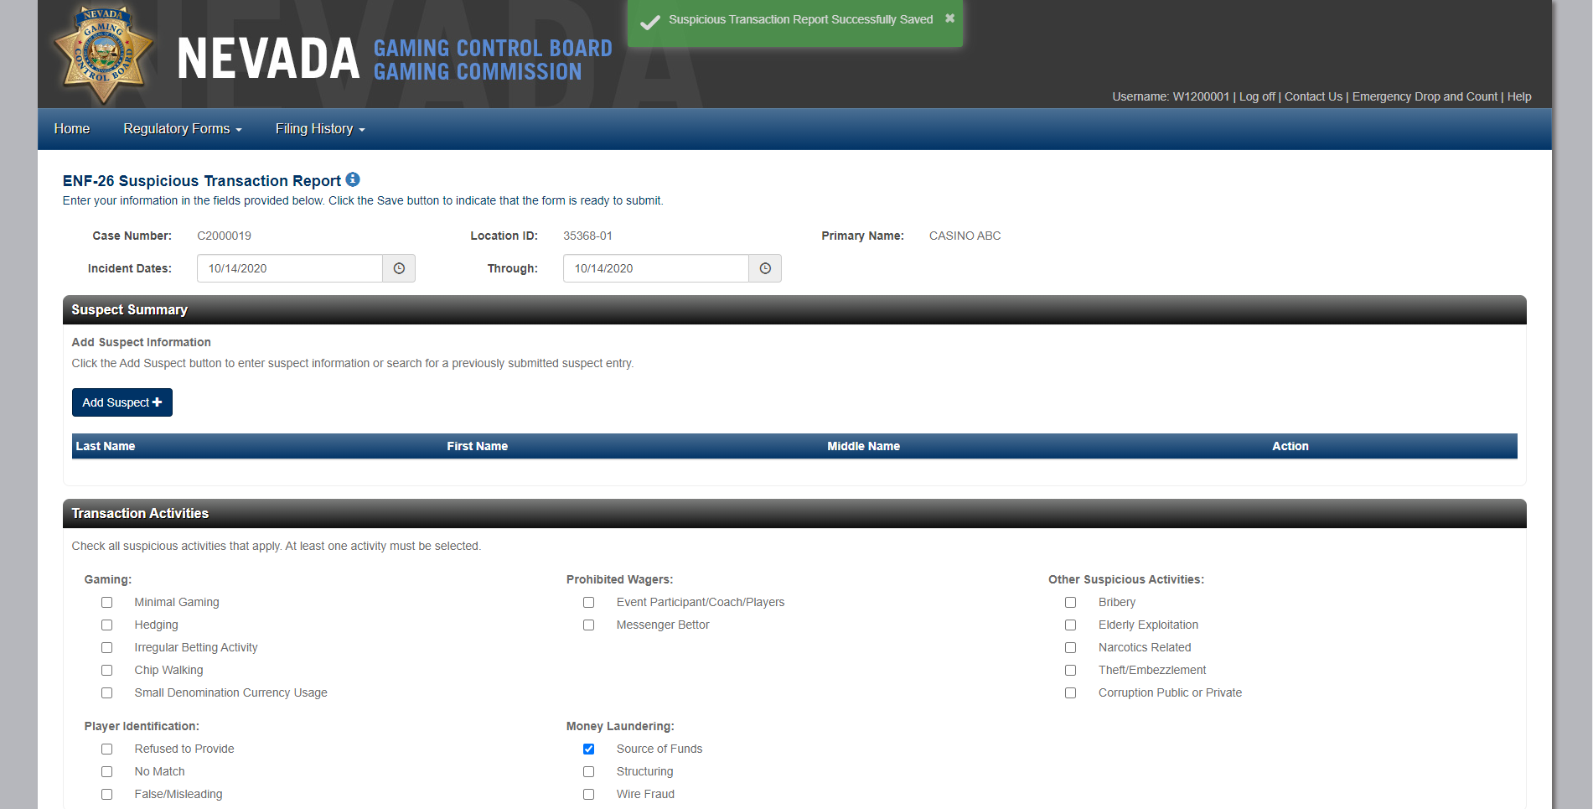
Save ENF-26: An ENF-26 can be saved once an activity is selected, a ‘Suspicious Transaction Successfully Saved’ message displays briefly & the saved ENF-26 can be edited from Forms in Process.

Slide 20
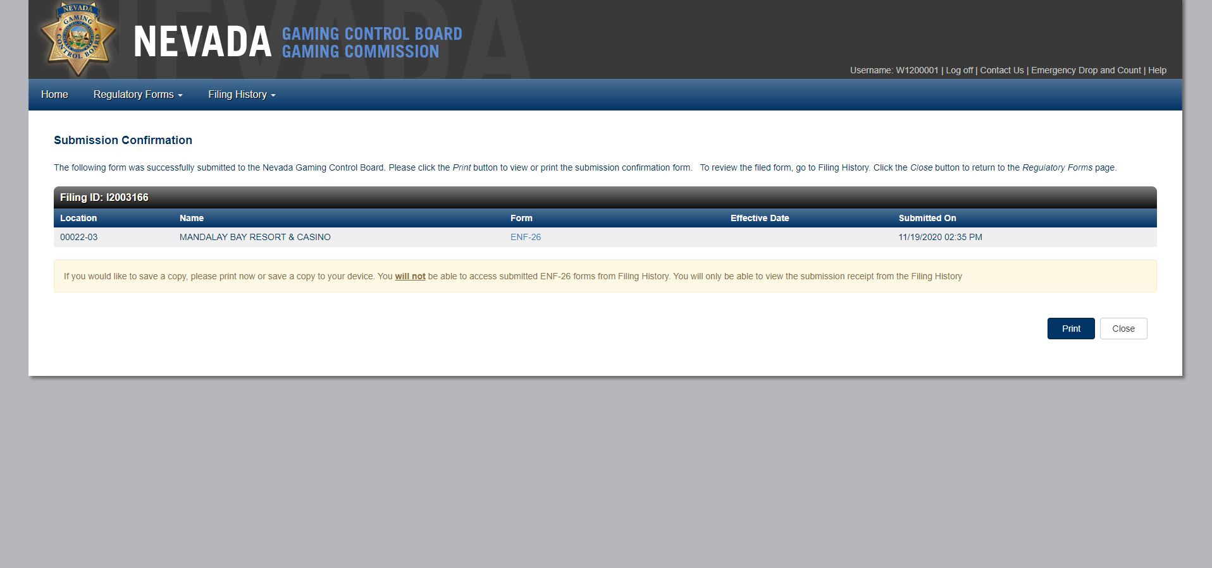
Submit ENF-26: An ENF-26 can be submitted once an activity is selected, a ‘Suspicious Transaction Successfully Submitted’ message displays briefly & the submitted ENF-26 can be amended under Amend Forms.

Slide 21
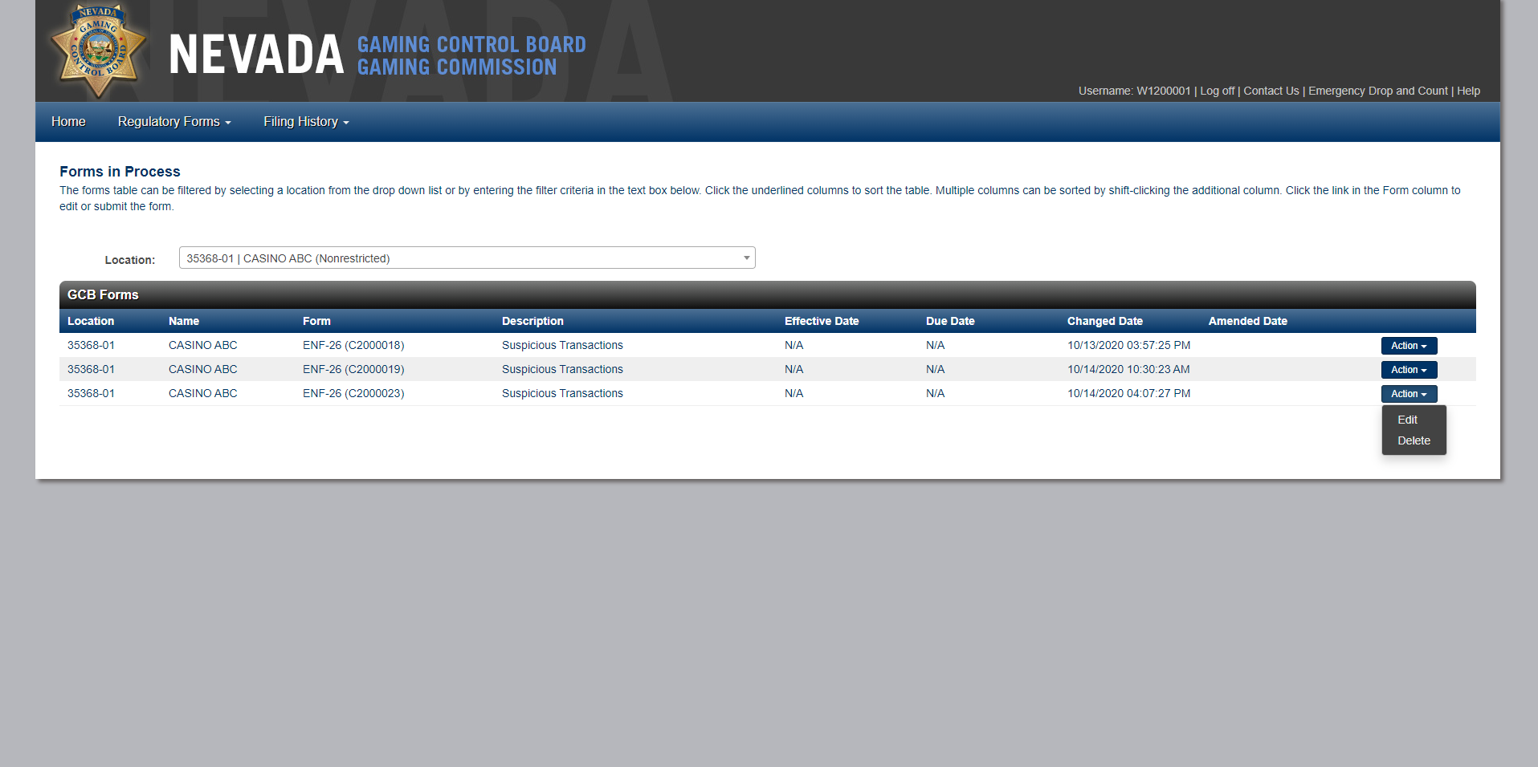
Forms in Process: Previously saved ENF-26 forms are saved in Forms in Process with the ability to edit or delete previously saved ENF-26 forms. The form can be Canceled, Printed, Saved or submitted.

Slide 22
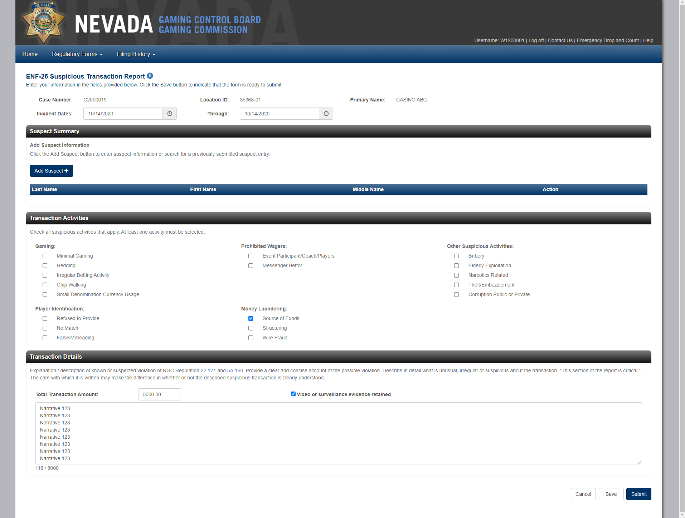
Forms in Process: Fields are prefilled with the initial ENF-26 form data, make changes to Suspect(s), Transaction Activities or Transaction Details then click Submit (header information cannot be edited).

Slide 23
Forms in Process: Submission Confirmation screen is displayed, click Print to download a PDF.

Slide 24
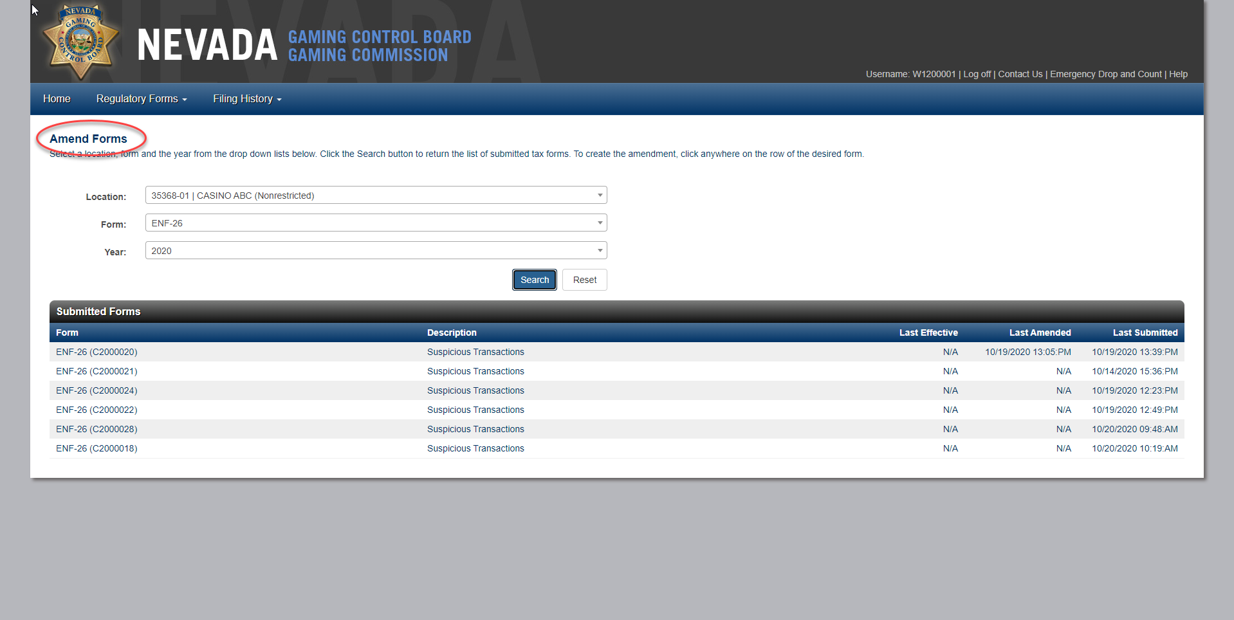
Amend Forms: Previously submitted ENF-26 forms can be amended from Amend Forms, enter Location, Form and Year then select an ENF-26.

Slide 25
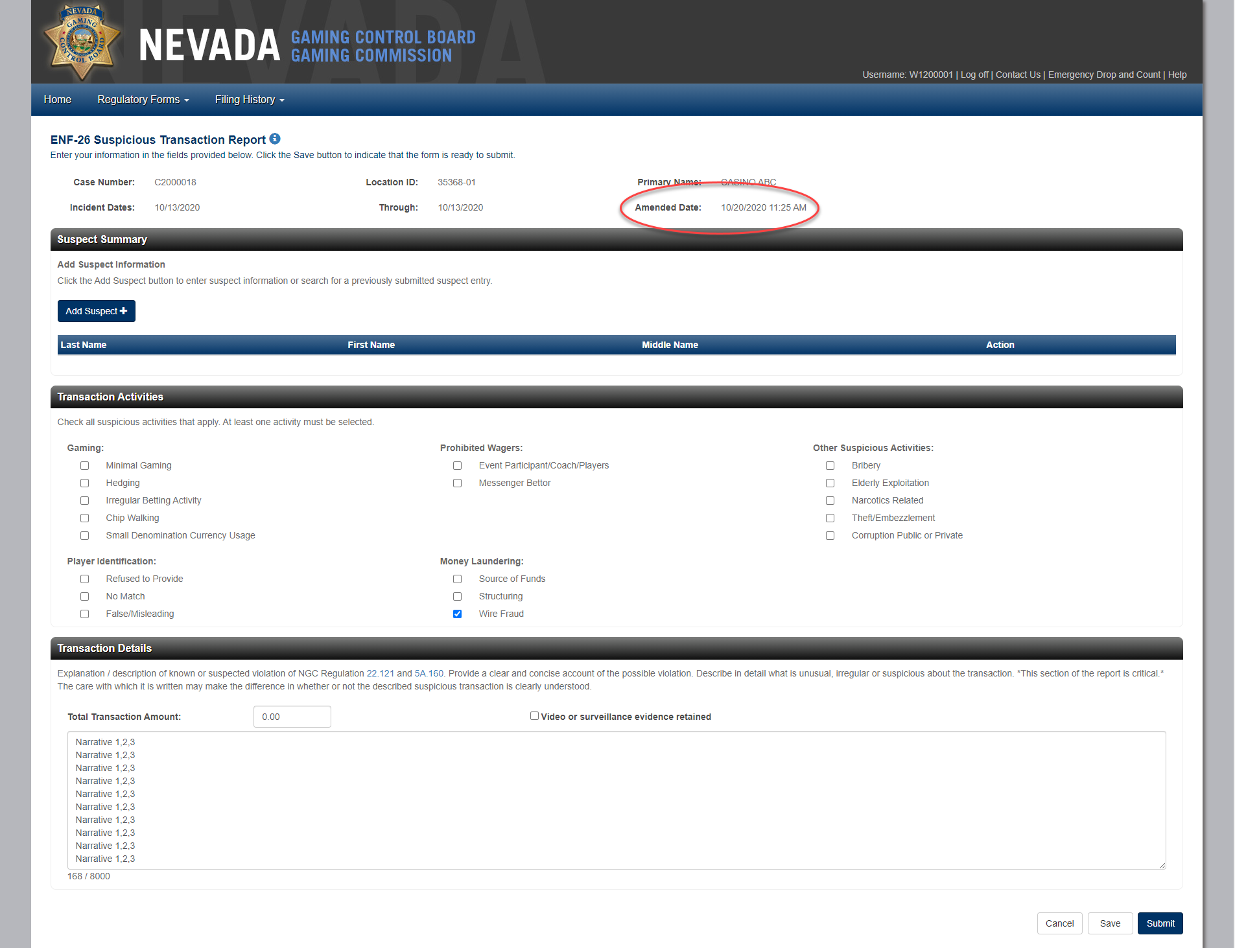
Amend Forms: Fields are prefilled with the initial ENF-26 form data, make changes to Suspect(s), Transaction Activities or Transaction Details then click Submit (header information cannot be edited).

Slide 26
Amend Forms: The Submission Confirmation displays, click Print to download a PDF version of the confirmation.

Slide 27
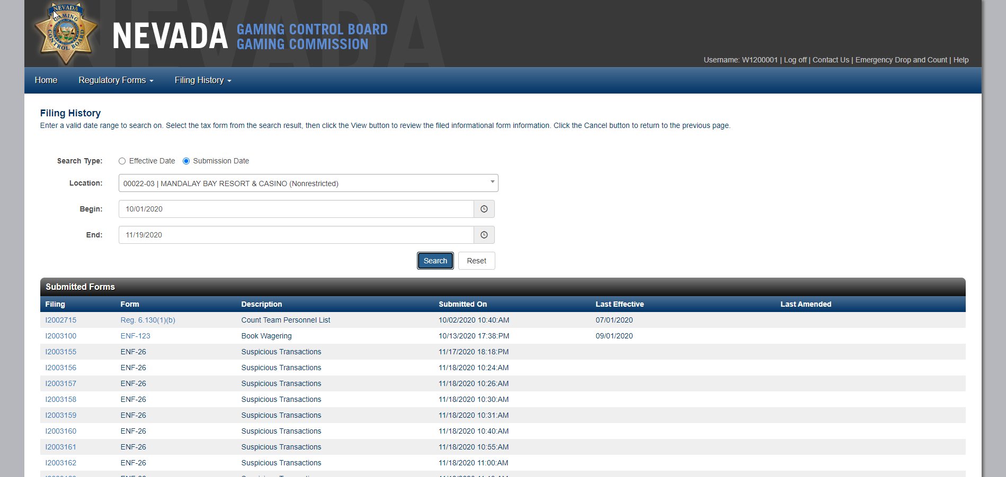
Filing History: The ENF-26 should be searched using Search Type; Submission Date. A Submission Confirmation can be download by clicking the Filing number for the applicable ENF-26. Please note that the Suspicious Transaction Report cannot be downloaded from Filing History therefore the ENF-26 form type is not displayed as a link.

